Slide 1

Organocity .com
Team 2
SEC E
Amit Kumar Karn
Saurav
Shrestha
Ram
Babu
Shah
Saugat
Adhikari
Kritika
Thapa
Yogesh
Shrestha

Slide 2





Work In Progress
INITIATION
PLANNING
executing
CLOSING
MONITORING AND CONTROLLING

Slide 3
INITIATION PHASE
The Project Charter
By- Amit Kumar Karn &
Saurav Shrestha
Team Contract
By- Saurav Shrestha

Slide 4
Work In Progress
INITIATION
PLANNING
executing
CLOSING
MONITORING AND CONTROLLING

Slide 5
PLANNING PHASE
Belbin Analysis
By- All Individual Members and Group
Skill Audit
By- All Individual Members and Group
Microsoft – Project
By- Saurav Shrestha

Slide 6
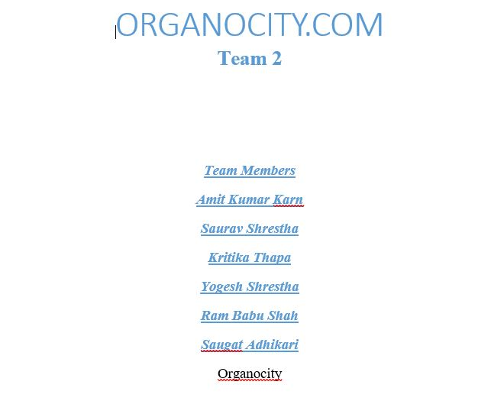
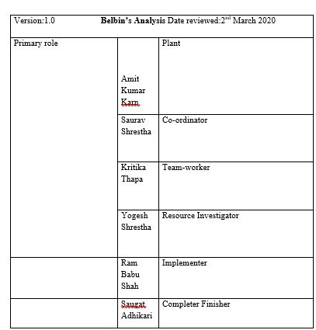
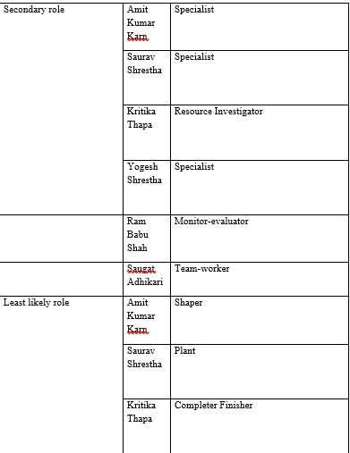
OUR BELBIN ANALYSIS

Slide 7
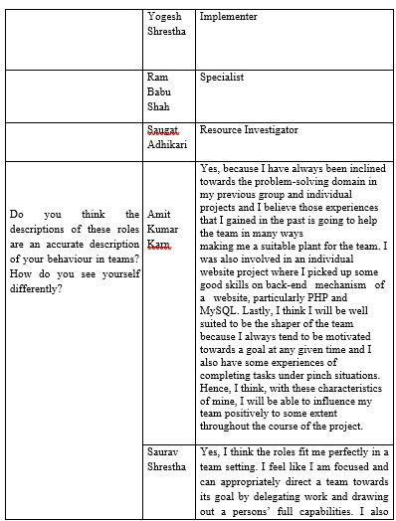
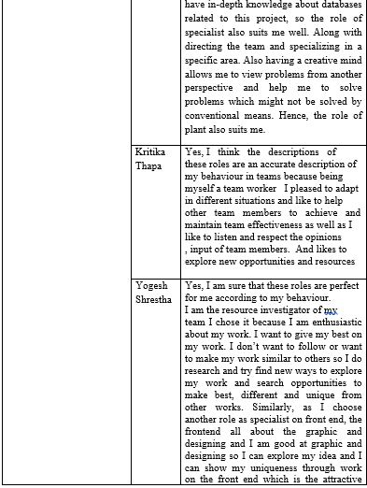
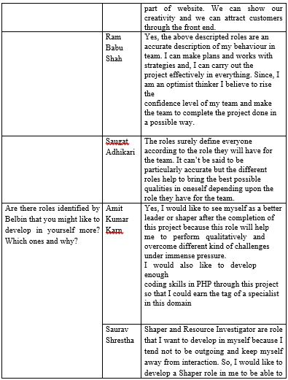

Slide 8
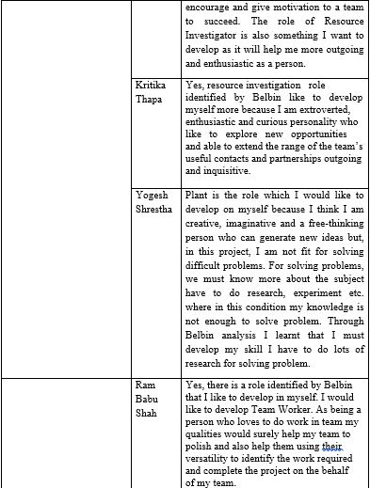
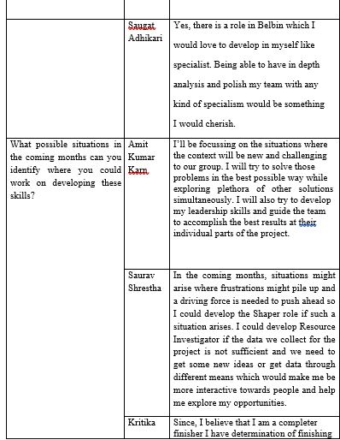
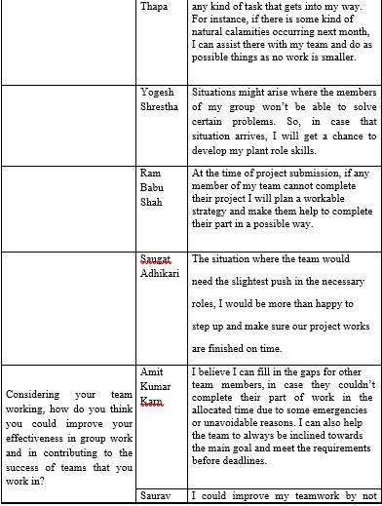

Slide 9
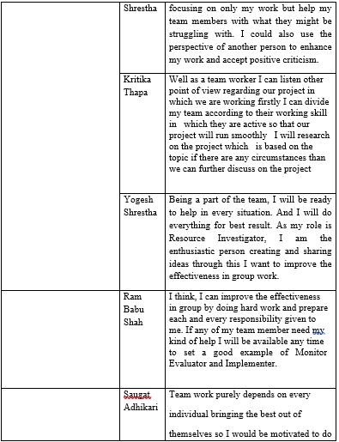
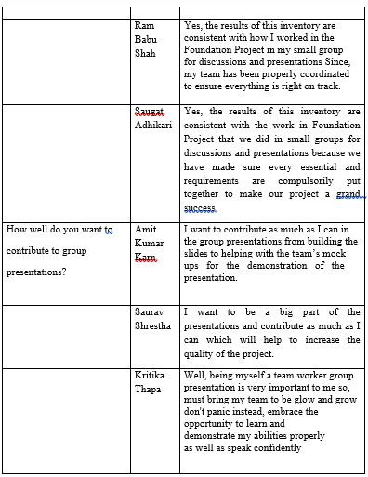
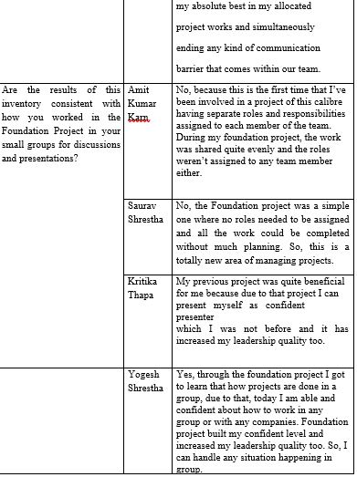
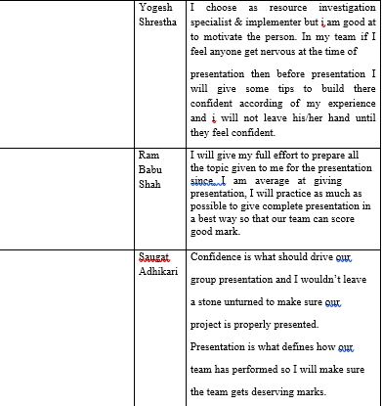

Slide 10
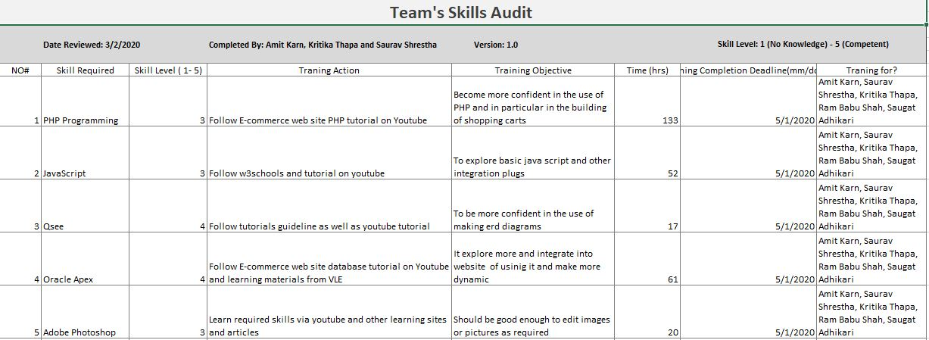
OUR SKILL AUDIT

Slide 11
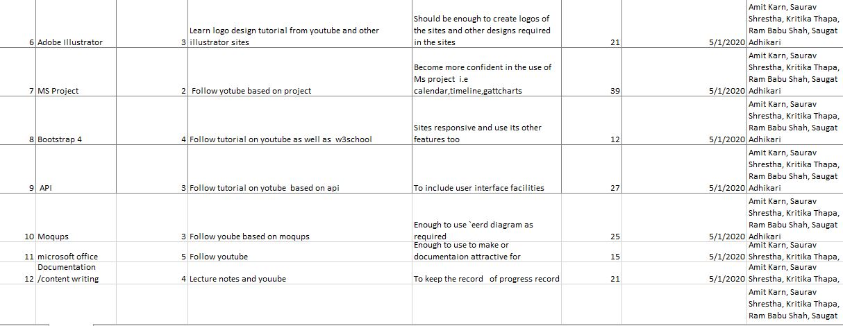

Slide 12
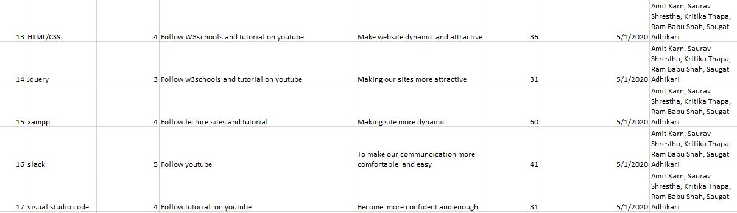

Slide 13
Work In Progress
INITIATION
PLANNING
executing
CLOSING
MONITORING AND CONTROLLING

Slide 14
EXECUTING PHASE
Design
Extended Entity Relationship Diagram
By- Amit Kumar Karn
Entity Relationship Diagram
By- Amit Kumar Karn
Composite Entity Relationship Diagram
By- Amit Kumar Karn & Saurav Shrestha
Requirement Catalogue
By- Amit Kumar Karn & Kritika Thapa
Use Case Diagram
By- Amit Kumar Karn
Logical Diagram
By- Amit Kumar Karn & Ram Babu Shah

Slide 15
Extended Entity Relationship Diagram

Slide 16
ERD & COMPOSITE MODEL

Slide 17
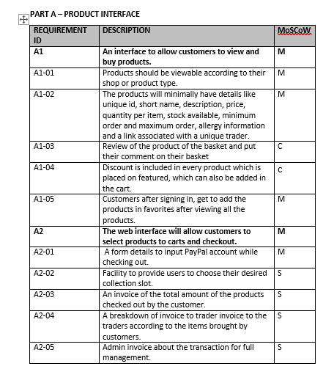
OUR REQUIREMENT CATALOGUE

Slide 18
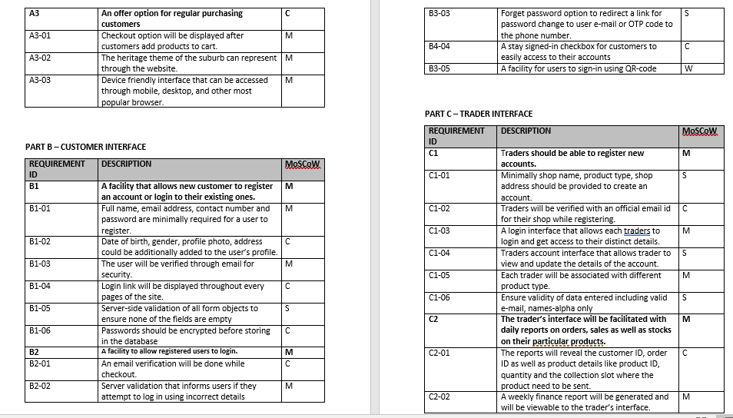
…

Slide 19
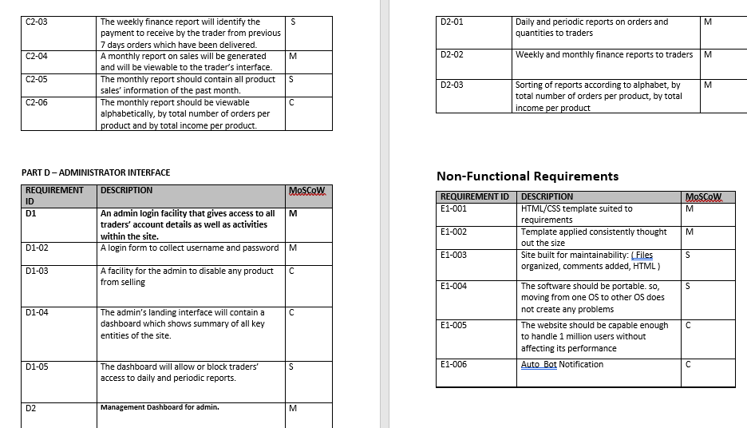
…

Slide 20
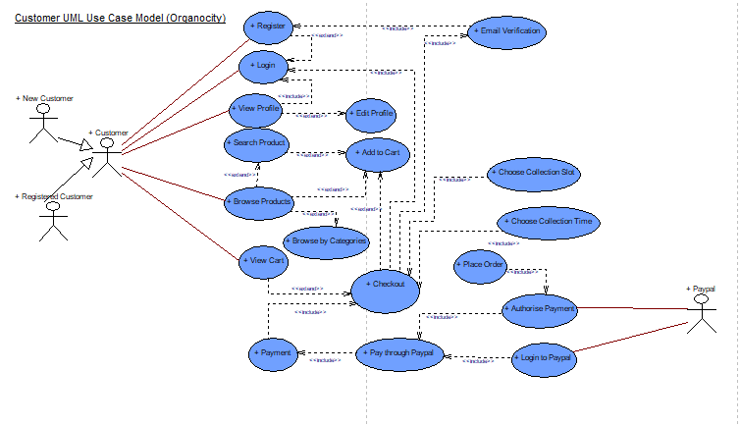
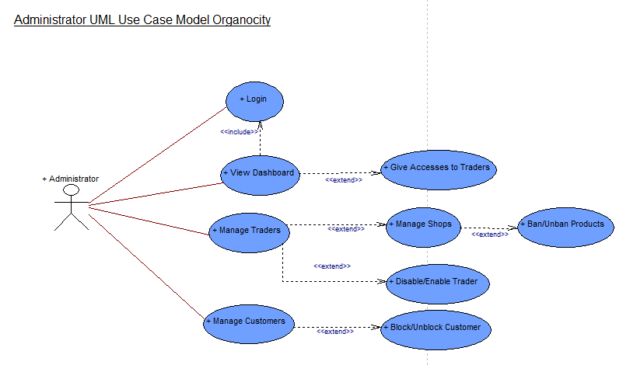
USE CASE DIAGRAMS

Slide 21
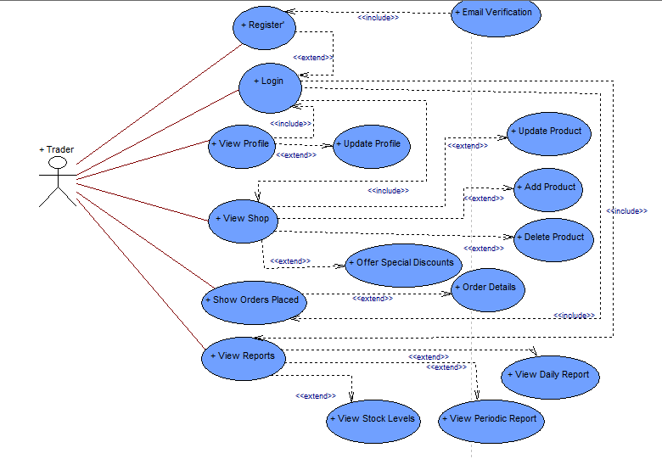
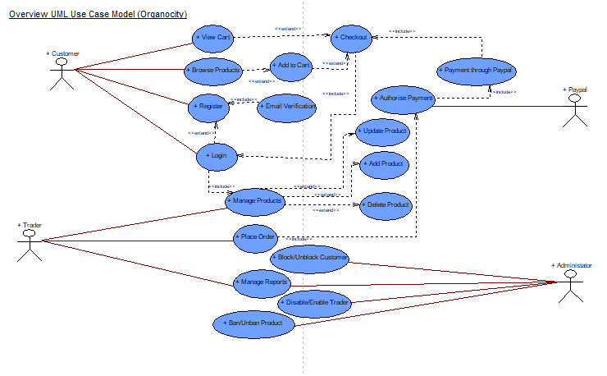
USE CASE DIAGRAMS

Slide 22
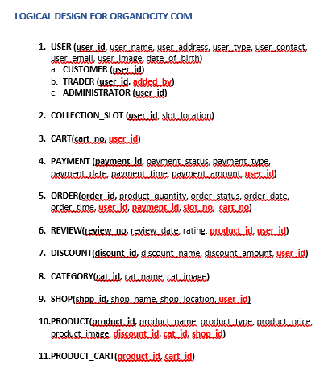
LOGICAL DIAGRAM

Slide 23
EXECUTING CONTINUE…
Implementing and Coding
By- Amit Kumar Karn, Saurav Shrestha, & Yogesh Shrestha
Oracle Tables
By- Amit Kumar Karn, Saurav Shrestha & Ram Babu Shah
Pictorials
By- Yogesh Shrestha
Website Logo
By- Yogesh Shrestha
Wireframe
By –Yogesh Shrestha

Slide 24

LOGO OF ORAGANOCITY.COM

Slide 25
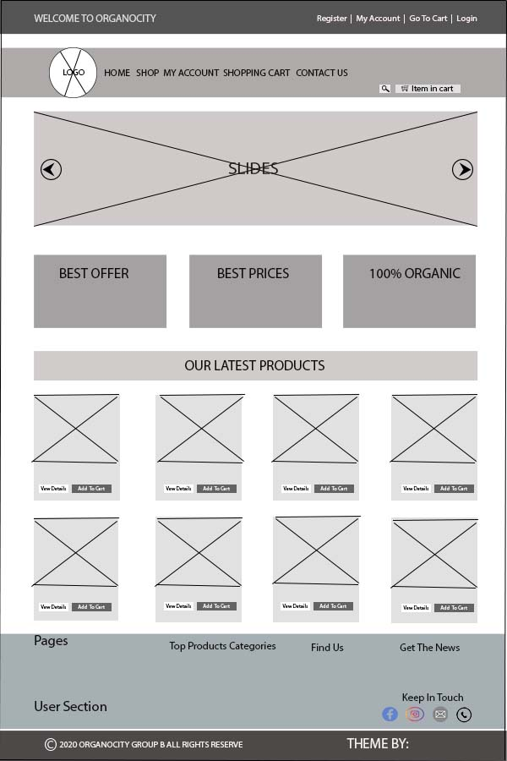
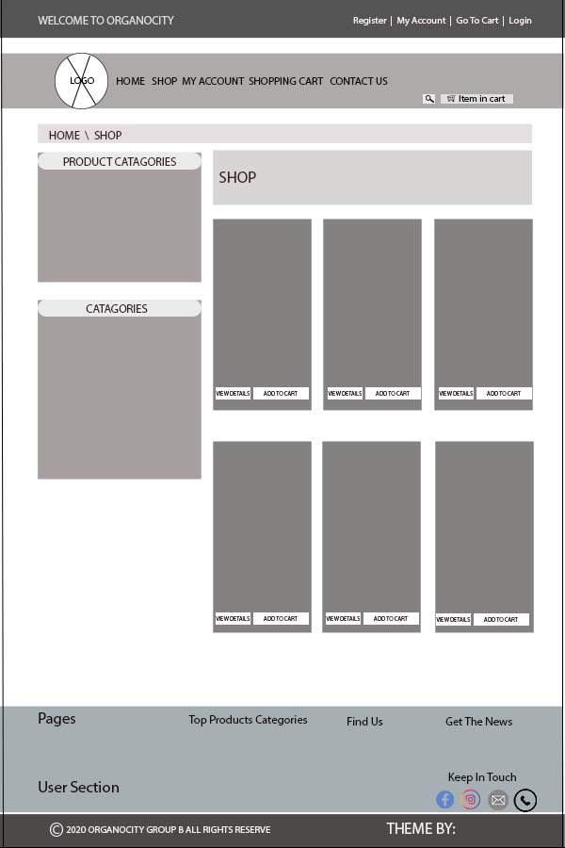
FRONT END HOME & SHOP PAGE

Slide 26
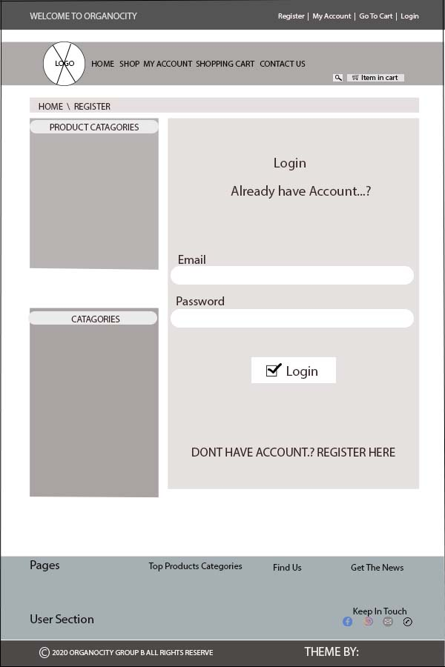
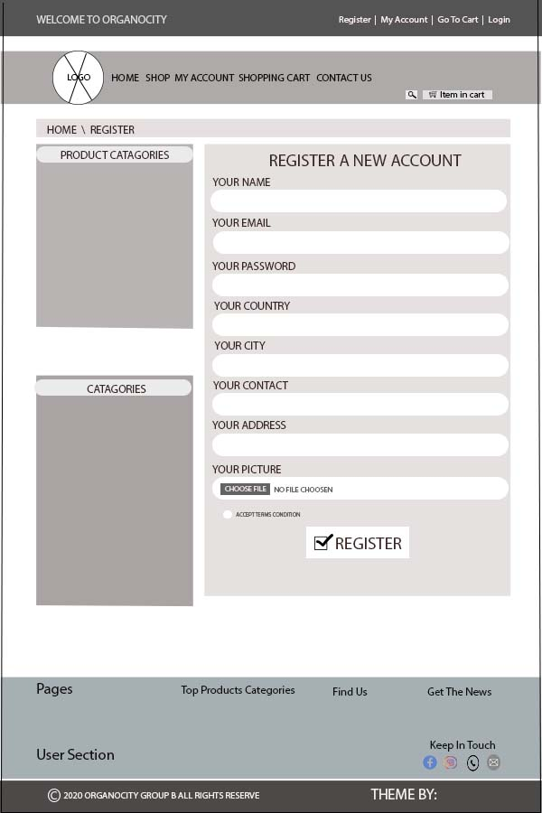
SIGN IN & REGISTER PAGE

Slide 27
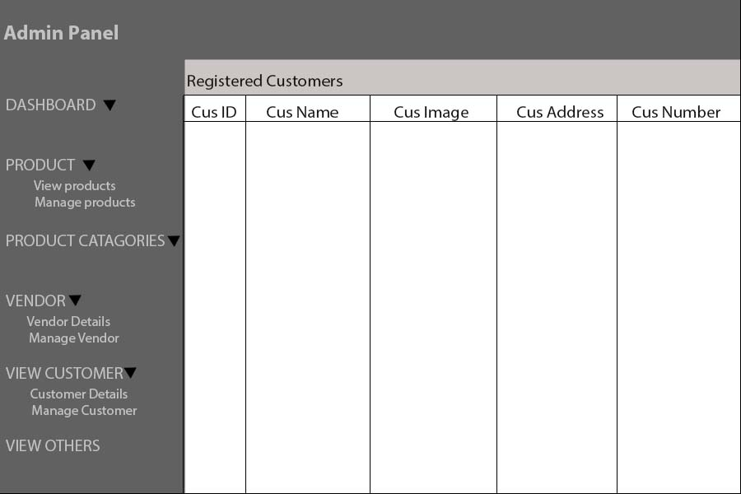
BACKEND TRADER AND CUSTOMER

Slide 28
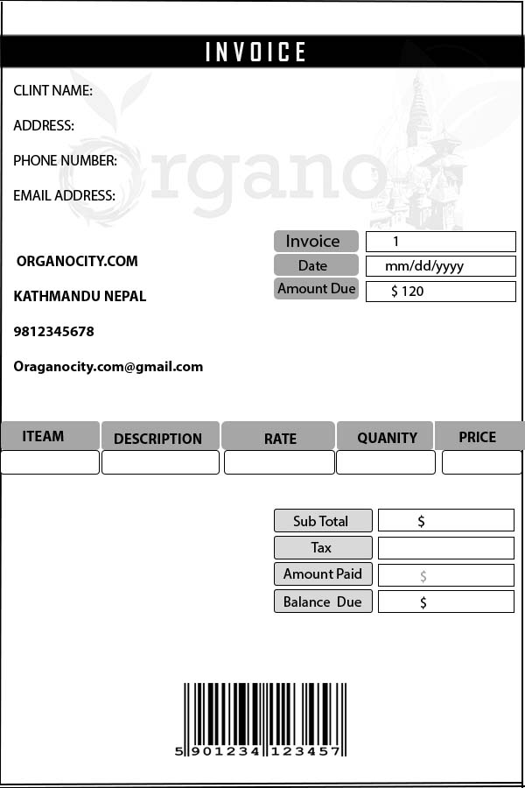
CART INVOICE

Slide 29
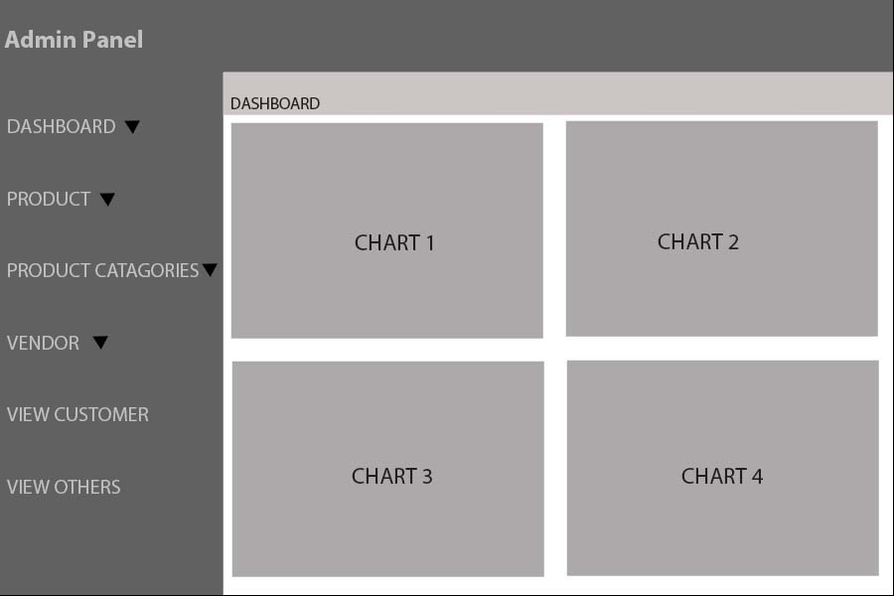
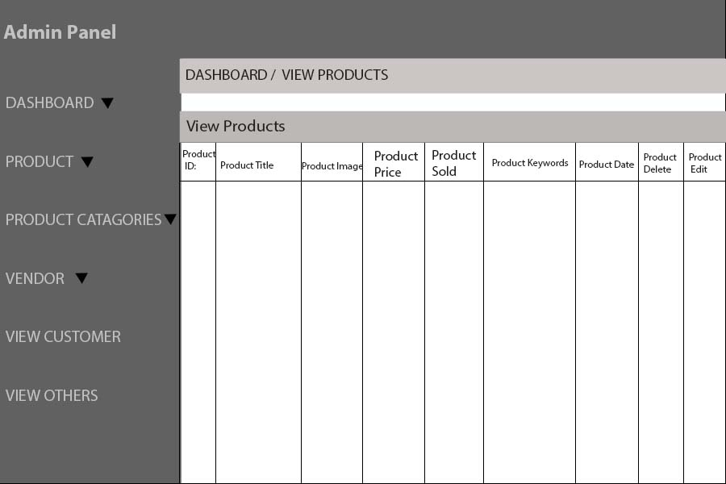
TRADER ORACLE & DASHBOARD

Slide 30
Work In Progress
INITIATION
PLANNING
executing
CLOSING
MONITORING AND CONTROLLING

Slide 31
MONITORING AND CONTROLLING PHASE
Guidelines
By- Amit Kumar Karn & Saurav Shrestha
Testing and Evaluation
By- Saugat Adhikari & Kritika Thapa

Slide 32
Work In Progress
INITIATION
PLANNING
executing
CLOSING
MONITORING AND CONTROLLING

Slide 33
CLOSING PHASE
Work In Progress
Presentation

Slide 34
THANK YOU ☺☺☺

